Slide 1

Using Blob Storage to Transfer data

Slide 2
Agenda
Understand what Polybase is.
How does Azure Storage fits into the Picture
How to setup External Data Sources
Archiving data
Transferring data Using Polybase and Linked Servers
Creating Database Backups directly to Blob

Slide 3
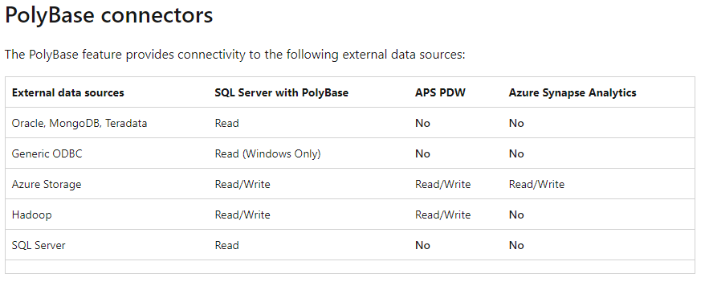
Polybase
PolyBase is a data virtualization feature for SQL Server.
PolyBase enables your SQL Server instance to query data with T-SQL directly from SQL Server, Oracle, Teradata, MongoDB, Hadoop clusters, Cosmos DB without separately installing client connection software.

Slide 4
Polybase uses
Query data stored in Hadoop from a SQL Server instance or PDW.
Query data stored in Azure blob storage.
Import data from Hadoop, Azure blob storage, or Azure Data Lake Store.
Export data to Hadoop, Azure blob storage, or Azure Data Lake Store.

Slide 5
How to use Polybase in an instance of SQL Server:
Install Polybase on Windows or Install Polybase on Linux.
Starting with SQL Server 2019 (15.x), enable Polybase in sp_configure, if necessary.
Create Master Database Key
Create Credentials
Create an external data source.
Create an external table.

Slide 6
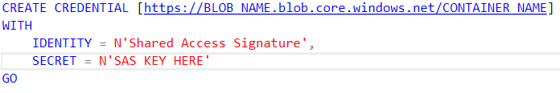
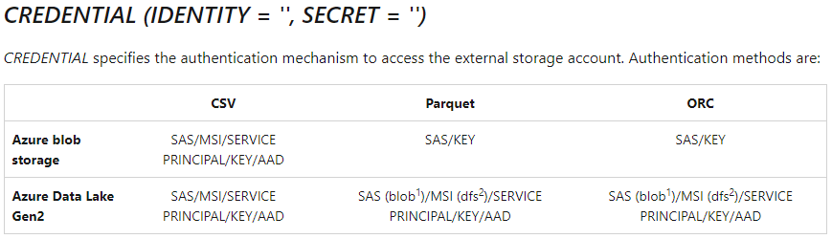
How to Create Credentials
Creates a server-level credential. A credential is a record that contains the authentication information that is required to connect to a resource outside SQL Server.

Slide 7
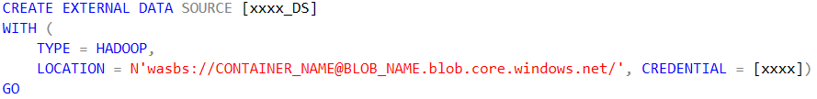
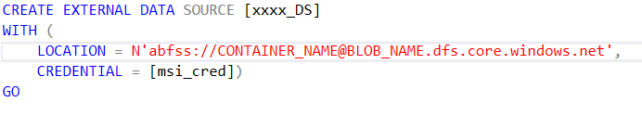
How to Create External Data Source
Creates an external data source for querying using SQL Server, Azure SQL Database, Azure SQL Managed Instance, Azure Synapse Analytics, Analytics Platform System (PDW), or Azure SQL Edge.

Slide 8
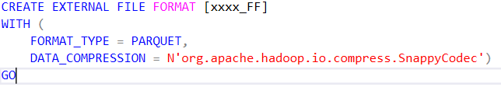
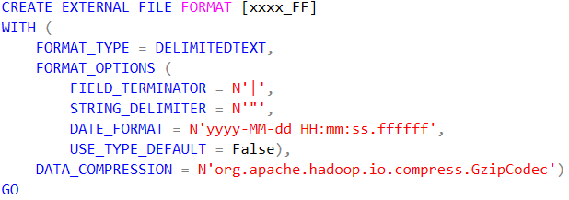
How to Create External File Format
Creates an External File Format object defining external data stored in Hadoop, Azure Blob Storage, Azure Data Lake Store or for the input and output streams associated with External Streams.

Slide 9
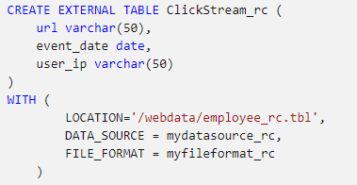
Creating External Tables and inserting data

Slide 10
Azure Blob Cold vs Hot
Hot tier
An online tier optimized for storing data that is accessed or modified frequently. The Hot tier has the highest storage costs, but the lowest access costs.
Cool tier
An online tier optimized for storing data that is infrequently accessed or modified. Data in the Cool tier should be stored for a minimum of 30 days. The Cool tier has lower storage costs and higher access costs compared to the Hot tier.
Archive tier
An offline tier optimized for storing data that is rarely accessed, and that has flexible latency requirements, on the order of hours. Data in the Archive tier should be stored for a minimum of 180 days.

Slide 11
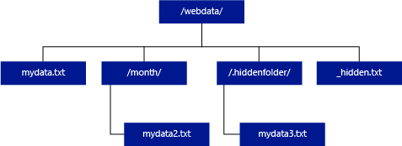
Directory Structure

Slide 12
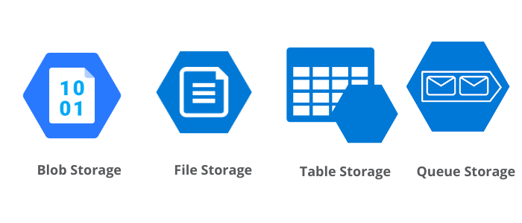
Azure Blob Storage
Azure Blob storage is Microsoft's object storage solution for the cloud.
Blob storage is optimized for storing massive amounts of unstructured data.
*Unstructured data is data that doesn't adhere to a particular data model or definition, such as text or binary data.

Slide 13
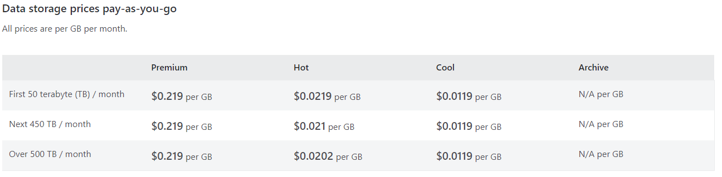
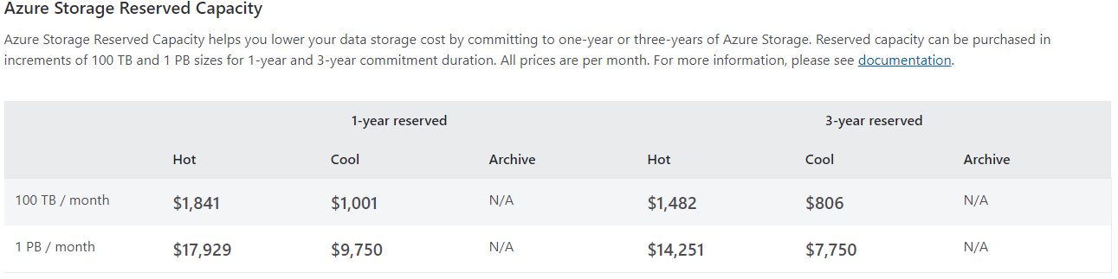
Azure Blob Costs

Slide 14
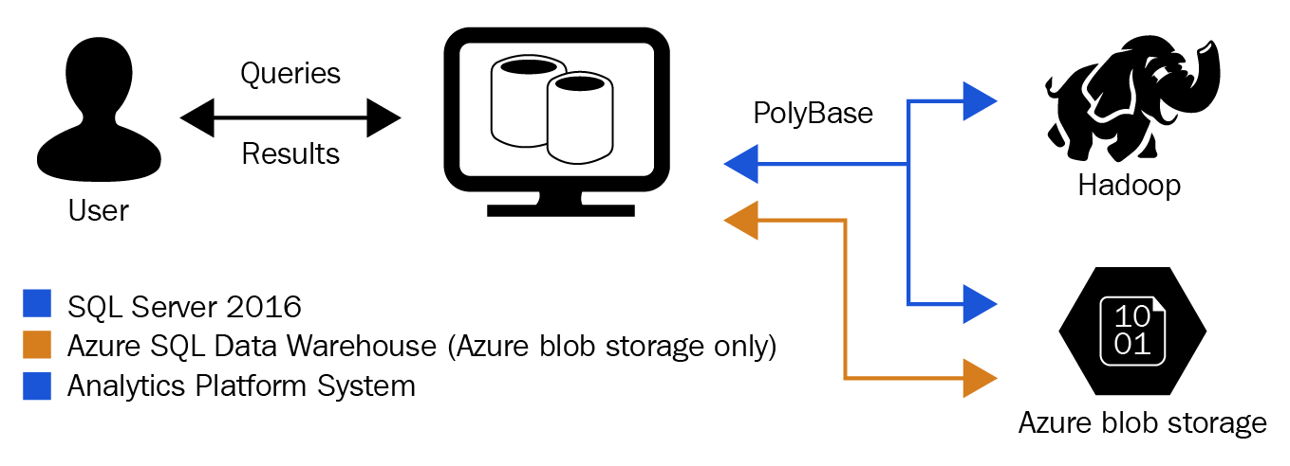
Archiving data using Polybase and Azure Blob Storage
https://www.sqlshack.com/sql-server-polybase-external-tables-with-azure-blob-storage/

Slide 15
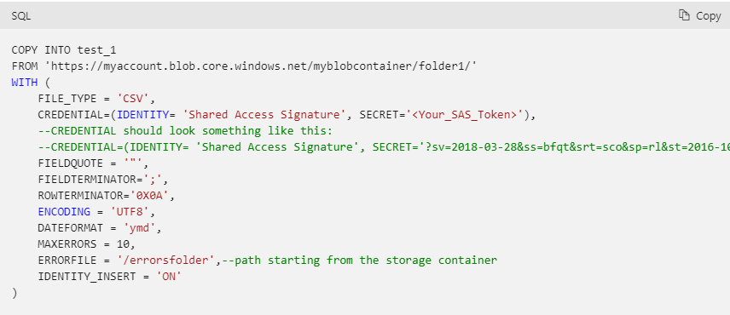
COPY INTO
The COPY statement provides the most flexibility for high-throughput data ingestion into Azure Synapse Analytics.

Slide 16
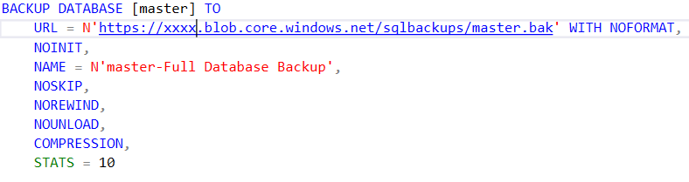
CREATING BACKUPS into Azure Blob Storage

Slide 17
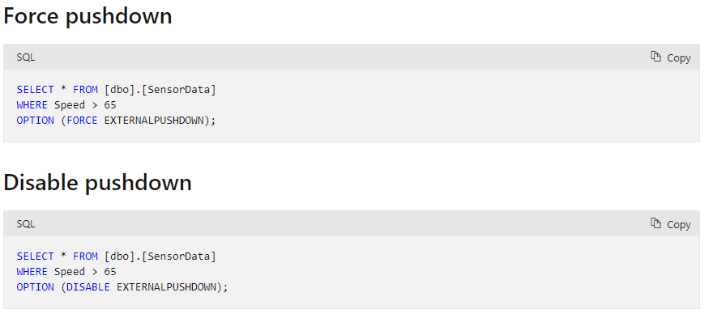
Polybase Pushdown
Use TF6408

Slide 18
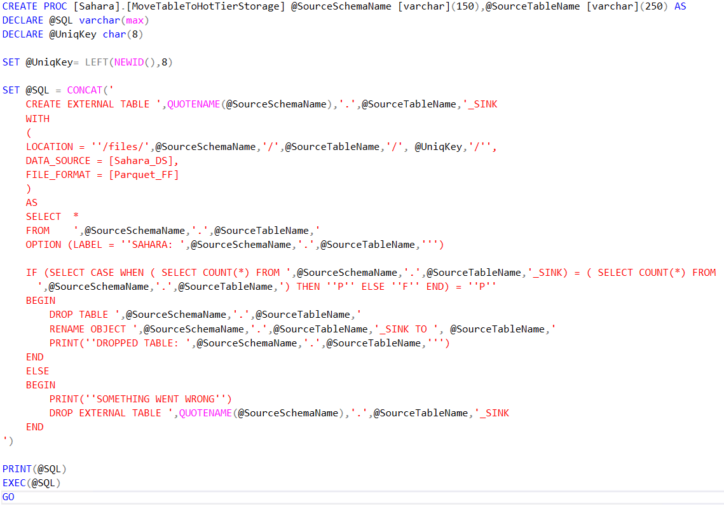
Nugget

Slide 19
Questions

